Slide 1
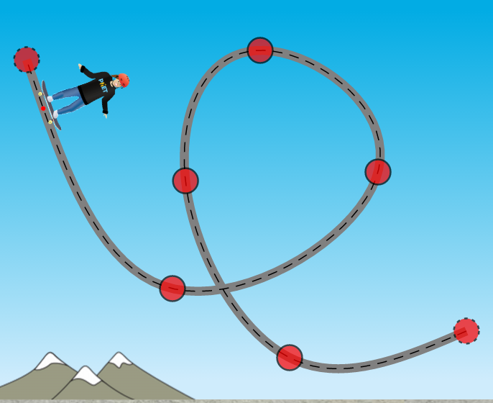
Extra Challenge
Repeat Part 2b with increased mass of skater.
How does this affect your results?
Create a working loop-the-loop
How many loops can you make work?
What type(s) of starting energy are required for the skater to be successful?
Can you identify 2 types of energy? (Explain)
Describe the types of energy at critical points in the track.

